Slide 1


INTRODUCTION TO HARDWARE SECURITY
BY AMAN JESWANI & PV SAI KUMAR

Slide 2
CONTENTS
1
2
3
4
5
Design Flow
Characteristics of the IC design Flow.
Globalization
The scenario before and after globalization affected the IC design process.
Motivation
Various Hardware Trojans at different stages of the IC design process.
C – I – A and Applied-Cryptography
(Confidentiality-Integrity-Availability.)
Examples & References
Necessary citations and resources.

Slide 3
DIGITAL IC DESIGN FLOW
System Specifications: This is the initial step where the overall performance, functionality, physical and electrical specifications of the IC are defined. The outcomes from this phase include the functional, interface, and performance specifications for the design.
Architecture Design: This stage involves identifying the best approach to meet the specifications outlined in the previous step. It may involve defining a block-level architecture for the chip, including any subsystems or modules, and their interconnections.
Logic Design and Functional Verification: Here, the architecture is translated into a representation of logic gates or higher-level components. The design is described in a hardware description language (HDL), such as Verilog or VHDL. This design is then tested against the original specifications using a variety of techniques, such as simulation, formal verification, and emulation, to ensure it behaves as expected.
Synthesis: The logic design is converted into a gate-level netlist using a synthesis tool. The netlist is a description of the digital circuit in terms of gates and their interconnections. This netlist is optimized for area, power, and performance.
VLSI Design Flow: RTL to GDS https://onlinecourses.nptel.ac.in/noc23_ee137/preview

Slide 4
DIGITAL IC DESIGN FLOW
Physical Design: The physical design step is often broken down into several sub-steps:
Floor-planning: Deciding the layout of the blocks in the chip. This includes the arrangement of blocks, and planning for power, clock, and I/O signal routing.
Placement: Placement involves placing the logic gates within the blocks. The aim is to minimize area and interconnect lengths to save power and improve speed.
Clock Tree Synthesis (CTS): This involves designing the clock distribution network to ensure that clock signals reach all flip-flops and other clocked elements at the same time.
Routing: This step involves creating the interconnections between the elements. Routing algorithms aim to optimize the performance, power, and area.
Layout Verification: After physical design, several checks are performed to verify that the layout is correct and manufacturable. These checks include Design Rule Check (DRC), Layout Versus Schematic (LVS), and Antenna Checks.
Timing Analysis: The post-layout netlist is subjected to static timing analysis to ensure all timing constraints are met. If they are not met, the design goes back to the previous steps for optimization.
Tape-Out: The final design is converted into a format suitable for manufacturing. This process is often referred to as 'tape-out'.
Fabrication, Packaging, and Testing: After tape-out, the design is sent for fabrication, where it is manufactured on silicon wafers. The fabricated ICs are then packaged and tested to ensure they meet the original specifications.
VLSI Design Flow: RTL to GDS https://onlinecourses.nptel.ac.in/noc23_ee137/preview

Slide 5
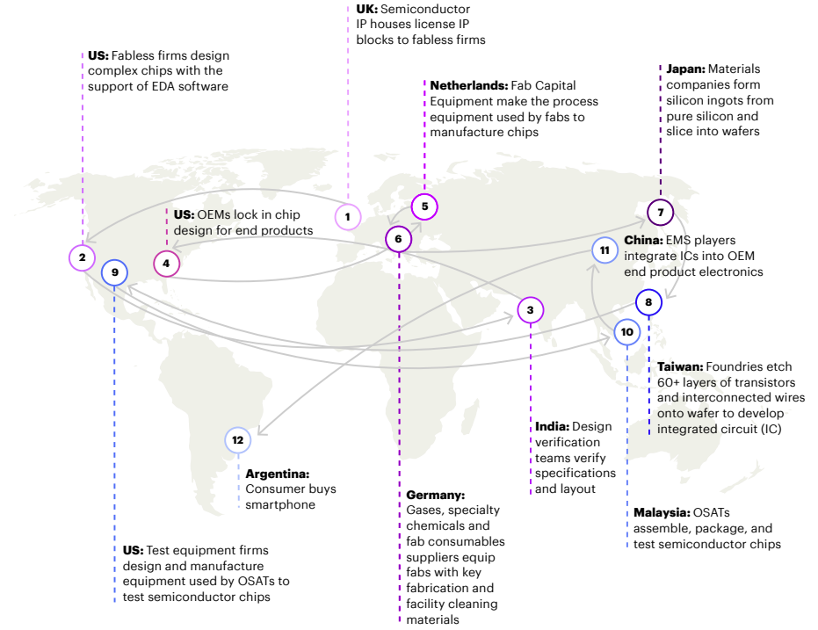
EFFECTS OF GLOBALIZATION
BEFORE: Design, Testing, Packaging, Assembly and Manufacturing were in-house.
AFTER: Design, Testing, Packaging, Assembly and Manufacturing were outsourced/off-shore.
Image Source: Introducing Semiconductors Blog

Slide 6
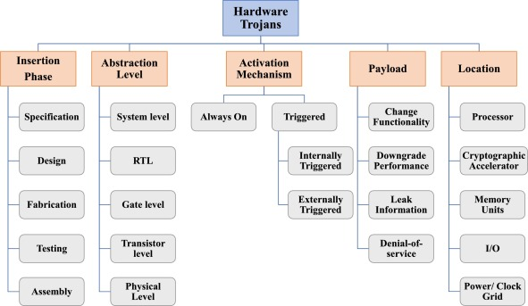
WHY DO WE NEED HARDWARE SECURITY? MOTIVATION: HARDWARE TROJANS & OTHER THREATS
A Hardware Trojan (HT) is a malicious modification of the hardware circuitry that can be activated to cause unexpected behavior in electronic devices or systems. They are often embedded at the hardware level, making them difficult to detect and prevent. They can be introduced at any stage of the IC design or manufacturing process. Other threats include Physical Attacks, Side Channel Attacks, Counterfeiting and IP Theft, Supply Chain Attacks, Reverse Engineering, Design and Manufacturing Flaws.
Image Source: Hardware Trojans Book Chapter

Slide 7
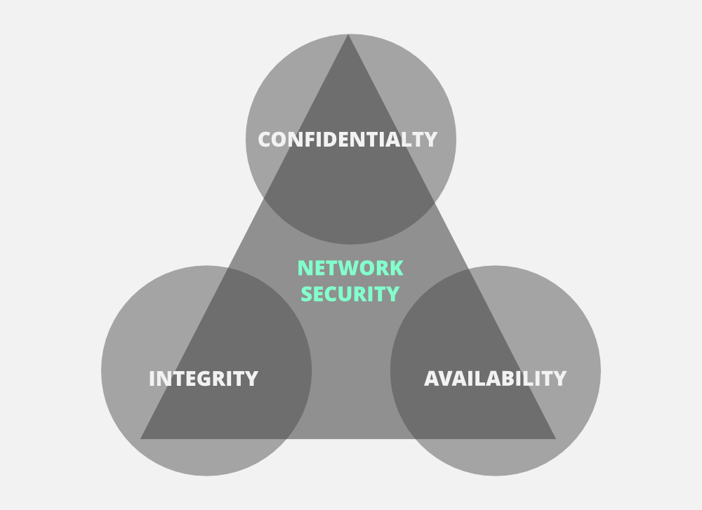
C-I-A TRIAD
Confidentiality: This principle is about ensuring that the information in the hardware system is accessible only to those authorized to access it. This means that measures should be in place to protect sensitive data from unauthorized access, whether it's stored on the device, in transit between devices, or in use.
Integrity: This principle refers to ensuring the accuracy and consistency of data over its entire lifecycle and is a measure of the reliability and trustworthiness of the data and system. In a hardware context, integrity means that the hardware should function as intended, without any unauthorized modifications. The hardware should also be able to detect and report any changes.
Availability: This principle is about ensuring that information and systems are accessible to authorized users when they need them. This means that the hardware systems should be operational, reliable, and performant. It also means ensuring that any hardware failures, whether due to errors, attacks, or environmental factors, can be quickly detected and rectified.
Image Source: C-I-A Article

Slide 8
PREREQUISITE FUNDAMENTALS: APPLIED CRYPTOGRAPHY
Applied cryptography is the practice of using cryptographic principles and techniques to secure communication and information systems in the real world. It involves the application of mathematical algorithms and protocols to encrypt and decrypt data, ensuring that information remains confidential, unaltered, and authentic during storage and transmission. Applied cryptography also includes the generation and management of cryptographic keys, the design and implementation of cryptographic systems, and the integration of these systems into broader security architectures. It plays a crucial role in numerous areas including internet security, digital currencies, secure communications, and data privacy. The ultimate goal of applied cryptography is to provide secure and reliable systems that are resilient against various types of attacks, while remaining efficient and usable.

Slide 9
PREREQUISITE FUNDAMENTALS: APPLIED CRYPTOGRAPHY
DES (Data Encryption Standard): DES is a symmetric-key block cipher developed in the 1970s by IBM and adopted by the U.S. government. It operates on 64-bit blocks of data, using a 56-bit key (originally 64-bit, but 8 bits are used for parity checks). DES employs the Feistel structure where the block of plaintext to be encrypted is divided into two halves, with several rounds of processing applied. However, the advent of more powerful computing made it possible to break DES encryption via brute-force attacks, leading to the development of Triple-DES (3DES), which applies the DES algorithm three times to each data block. Nonetheless, DES and 3DES are now considered to be outdated due to their relatively short key lengths.
AES (Advanced Encryption Standard): To address the weaknesses of DES, the U.S. National Institute of Standards and Technology (NIST) initiated a process to develop a new encryption standard. The result was the Advanced Encryption Standard, adopted in 2001. AES is also a symmetric-key block cipher, but it supports larger block sizes (128 bits) and key sizes (128, 192, or 256 bits). AES operates through several rounds of substitutions, permutations, and mixing to transform the plaintext into ciphertext, with the number of rounds dependent on the key length. Today, AES is widely used globally and is considered to be very secure against all known practical attacks when used properly.
In terms of hardware security, both DES and AES can be implemented in hardware devices such as secure microcontrollers, encryption accelerators, or secure storage devices. Hardware implementations can offer benefits in terms of speed, power efficiency, and resistance against certain types of attacks compared to software implementations. However, they also have to be carefully designed and tested to ensure that they do not introduce new vulnerabilities, such as side-channel leakage.

Slide 10
REAL LIFE EXAMPLES
1. M-I-T-M attack on Netgear Routers
2. HID MERCURY ACCESS CONTROL VULNERABILITIES LEAVE DOOR OPEN TO LOCK MANIPULATION
3. HIGH-IMPACT VULNERABILITY LEAVES THOUSANDS OF SMES OPEN TO EXPLOITATION
4. INTEL INTRODUCES FIRST PROTECTIONS AGAINST CERTAIN PHYSICAL THREATS

Slide 11
REFERENCES
Free online courses/videos for cryptography and hardware security:
NPTEL
https://www.youtube.com/@introductiontocryptography4223/videos
https://www.youtube.com/watch?v=JoeiLuFNBc4&list=PLBlnK6fEyqRgJU3EsOYDTW7m6SUmW6kII
https://www.youtube.com/watch?v=jhXCTbFnK8o
RSA:
(Eddie Woo): https://www.youtube.com/watch?v=4zahvcJ9glg
Computerphile: https://www.youtube.com/watch?v=JD72Ry60eP4
Readings:
Hardware Security Tutorial/Magazine Article: Trustworthy Hardware
DES: fips46-3-DES-standard
AES: nist.fips.197-AES-standard
Fault Attacks:
https://ieeexplore.ieee.org/document/1580506
DFA on AES: https://link.springer.com/chapter/10.1007/11506447_4
Scan Chain Attacks:
AES: https://ieeexplore.ieee.org/stamp/stamp.jsp?arnumber=1677712
DES: https://ieeexplore.ieee.org/document/1386969
Hardware Trojans:
Identifying and classifying HTs: https://ieeexplore.ieee.org/document/5604161
Research Overview: https://dl.acm.org/doi/10.1145/2906147
HatCH HT detection: https://ieeexplore.ieee.org/document/7820150
Logic Locking: https://ieeexplore.ieee.org/document/7140252

Slide 12

NOTES/ROADMAP/SUGGESTIONS
If you’re just beginning to explore the field of hardware security, we would suggest taking up an online course/video from the list provided and then reading papers from the reading list one-by-one gradually with the course.

Slide 13

THANK YOU!

